Slide 1
Narratives from The Early History of F#
Don Syme
Principal Researcher and Community Contributor, Microsoft
@dsymetweets, fsharp.org/history

Slide 2
A meta-talk about a meta-language
Loosely based on HOPL IV paper
From 1970s to 2021
From Milner, Newey, Morris to Today

Slide 3
History is always written selectively
I’ll be explicit about the narratives I’ve chosen

Slide 4
Narrative #1
A personal journey

Slide 5
Narrative #2
A community’s journey
(and origin mythology)

Slide 6
Narrative #3
Even in PL things don’t just happen. Things happen to people, who act, react and change in very human ways
creation, rejection, denial, stubbornness, cooperation, subversion, opportunism, …

Slide 7
Narrative #4
What happens when computing traditions with strong belief systems collide, both in industry and academia?

Slide 8
Narrative #5
The dynamic interplay between academic research and industry concerns in computing history

Slide 9
Narrative #6
The contradictions and dialectics present throughout the origins and history of ML-family languages

Slide 10

Narrative #7
The golden thread – what holds true in programming language design, what stands the test of time?

Slide 11
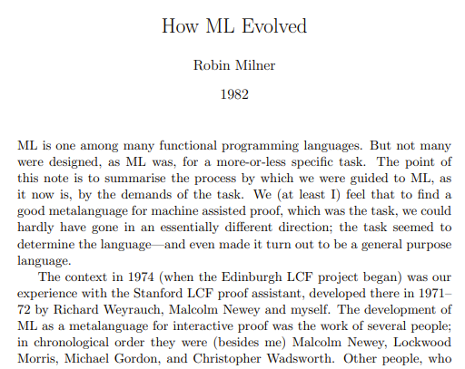
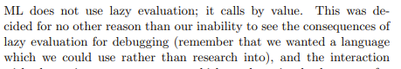
There are contradictions at the heart of the ML family of languages
Purity v. Practicality
Logic v. Pragmatism

Slide 12
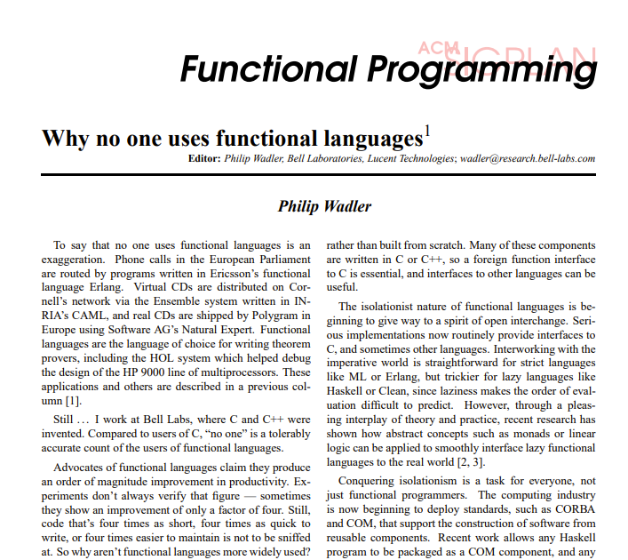
The World as It Was
(~1997)

Slide 13
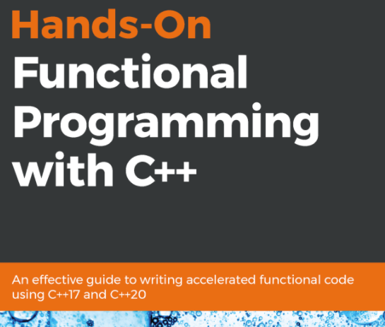
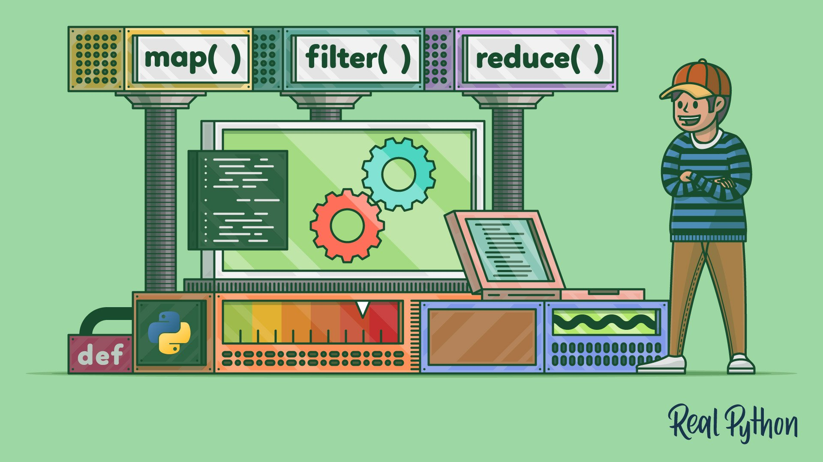
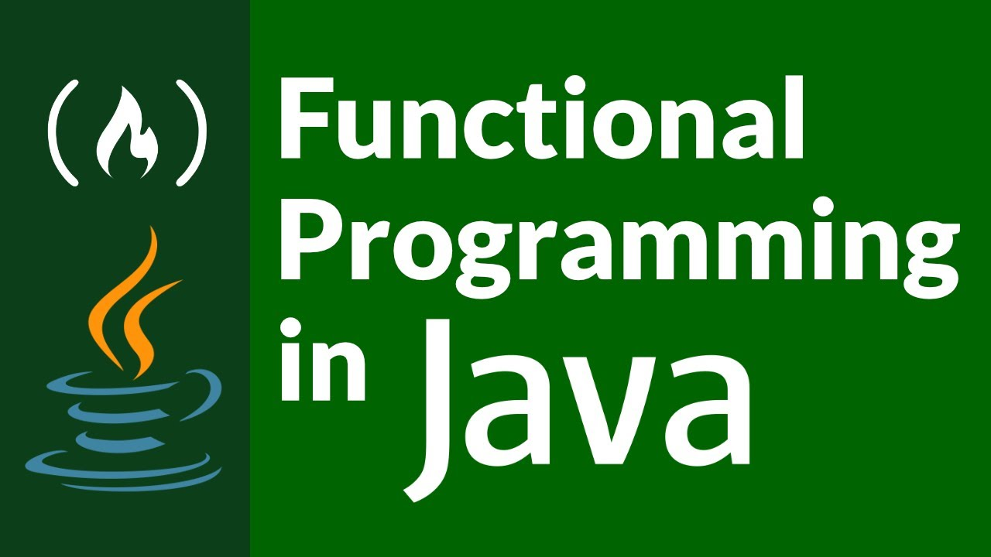
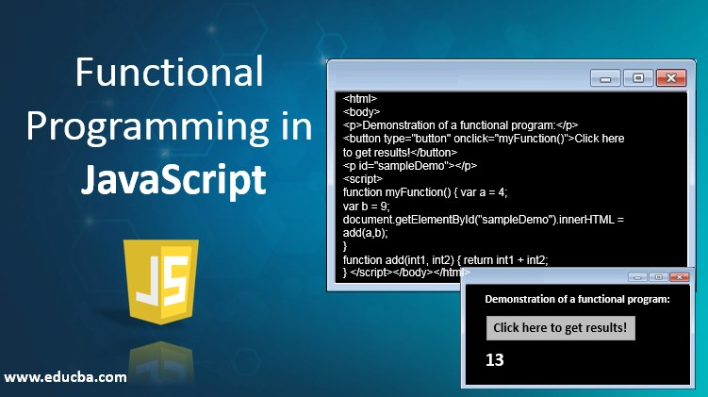
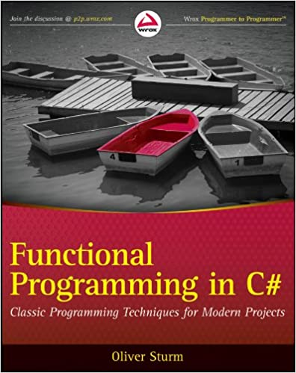
The World Today
Typed Functional Programming Techniques are Used Everywhere

Slide 14

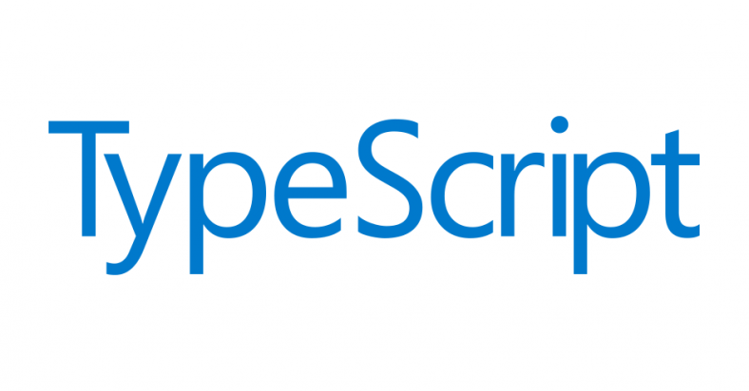



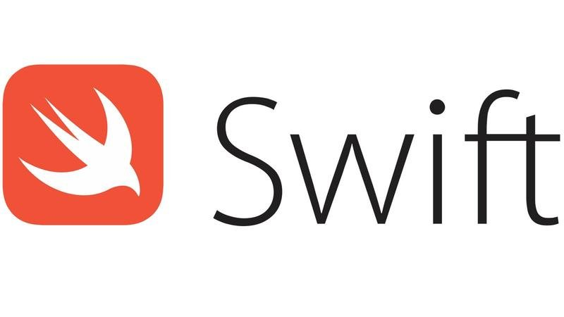

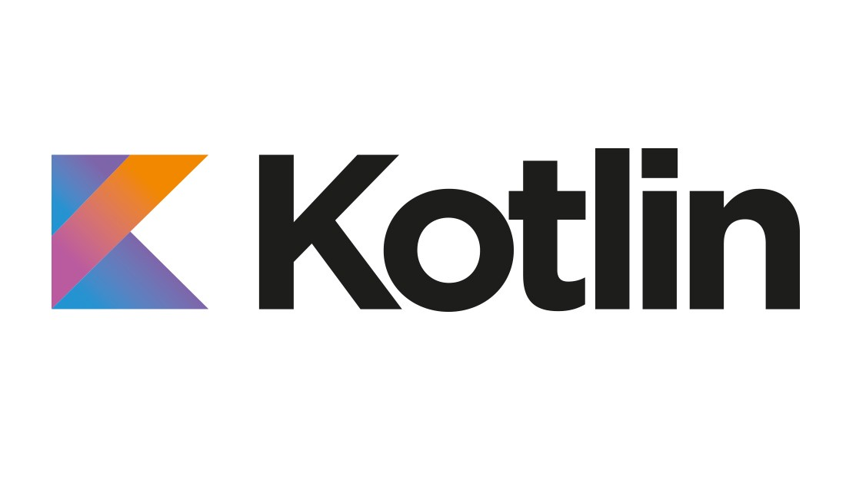
The World Today
Strongly Typed Functional Programming Languages are Usable Everywhere

Slide 15

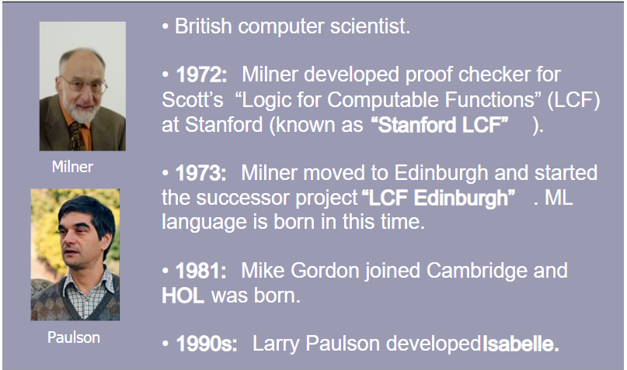
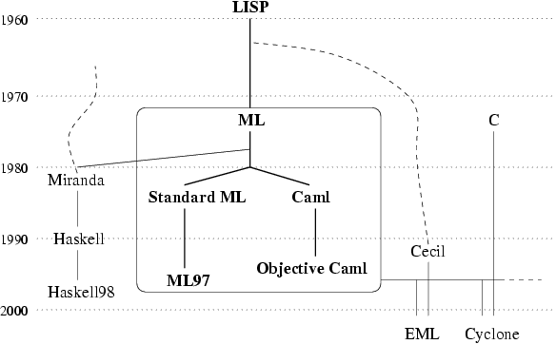


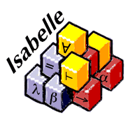
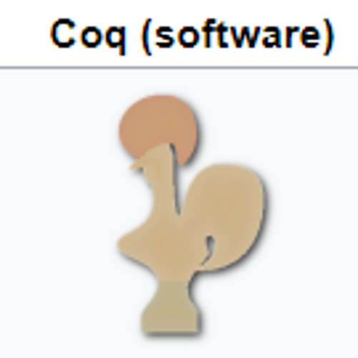
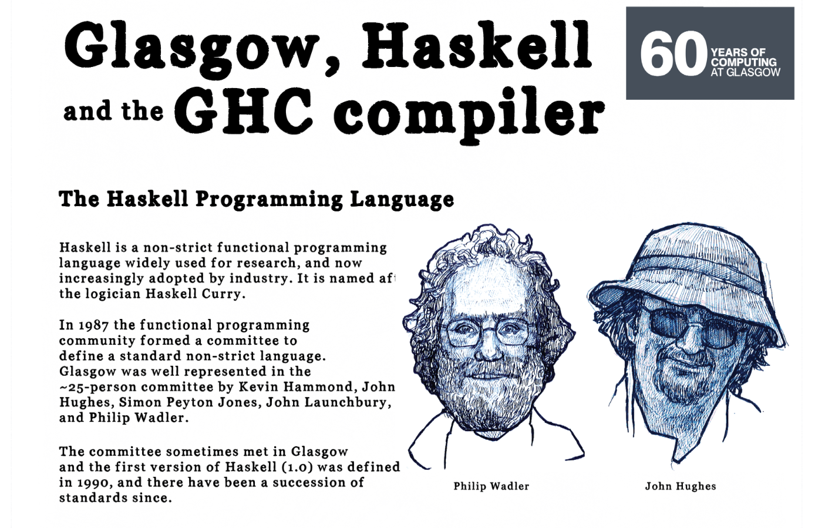
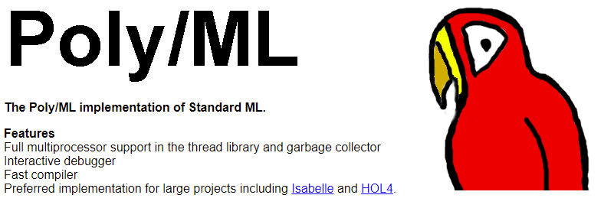
Rollback to 80s-90s
Strongly typed FP was small but active tribe.
Rooted in theorem proving, theory, Standard ML, Haskell, OCaml, experiments

Slide 16

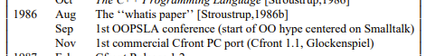
The Object-Oriented Tidal Wave, 1986-1998
A story in itself, colossal impact
On Platform Companies (Obj-C, C++, Java)
On Microsoft (C++, Java)
On CS Academia (Java)
On Every Programming Language

Slide 17
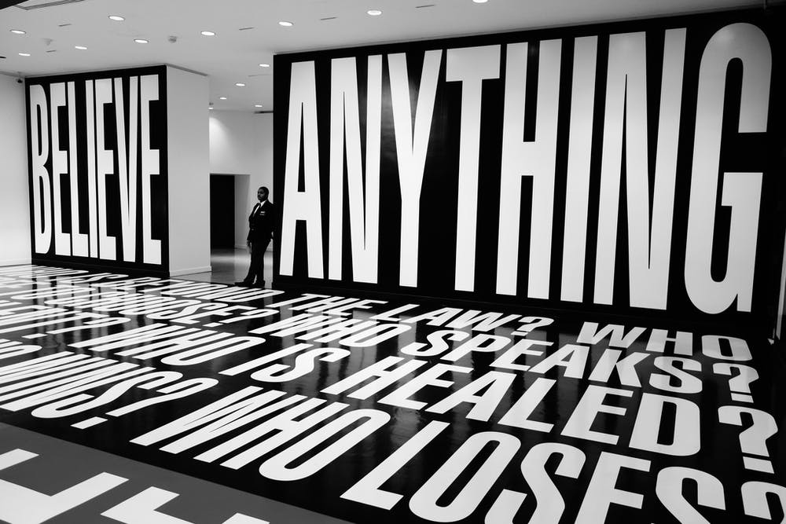
Response 1
Find something else to believe in

Slide 18
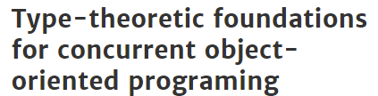
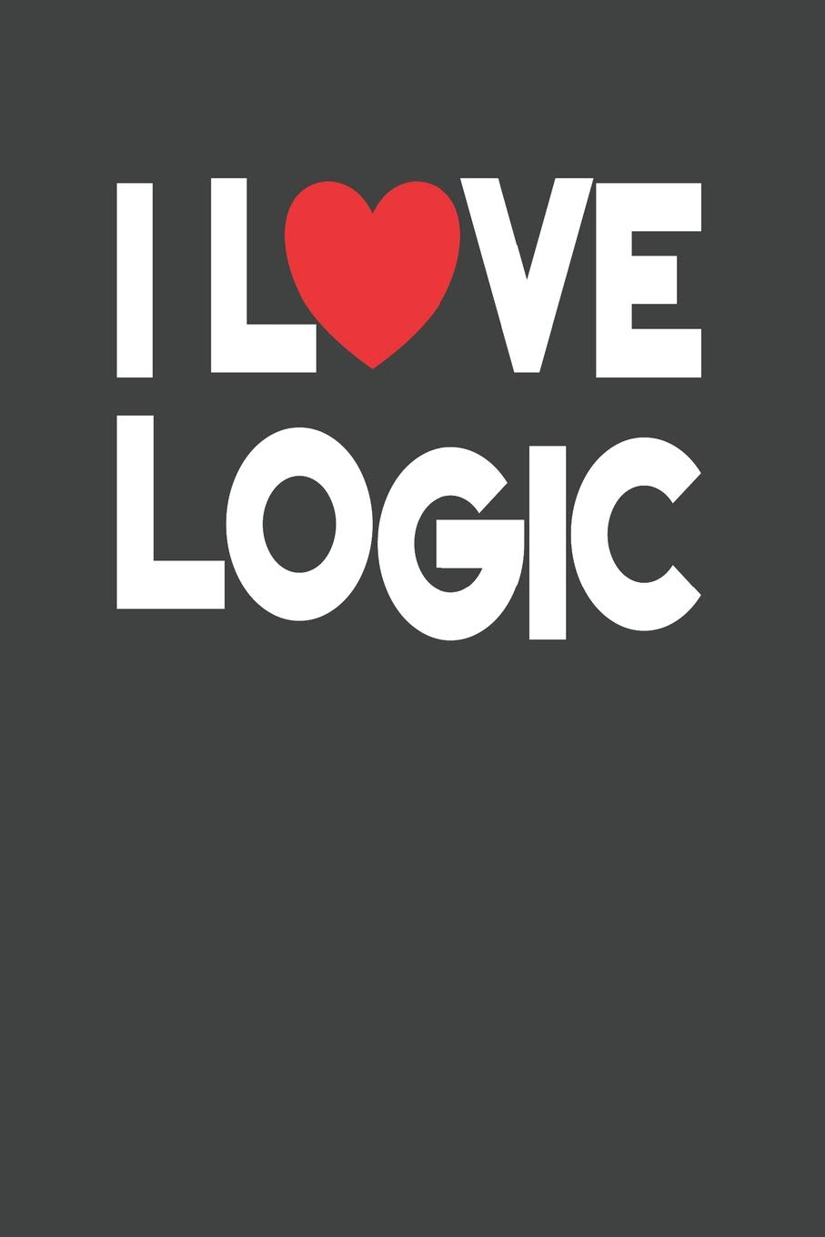
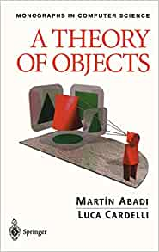


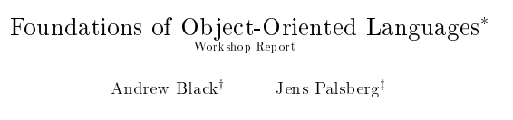
Response 2
Retreat to the fort! Focus on Foundations! Focus on Pure Functional! (and variations)

Slide 19
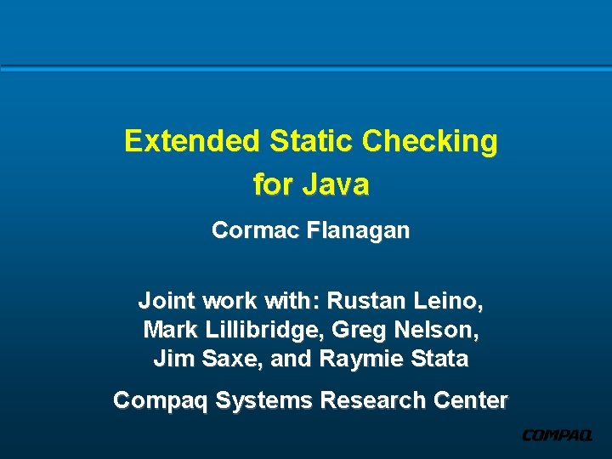

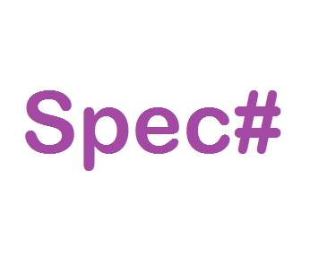
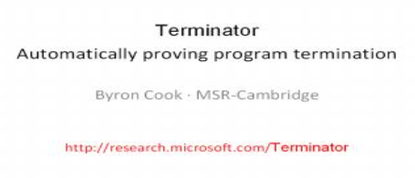
Response 3
Verify the stuff using functional/theory tools!
+ many other examples

Slide 20

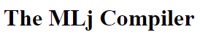
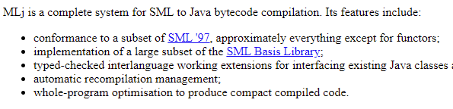
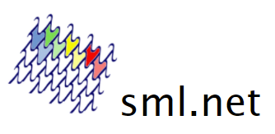
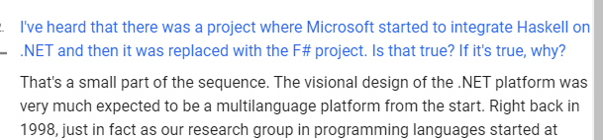
Response 4
Oh yeah! Get my language running on those object VMs!
+ many other examples

Slide 21
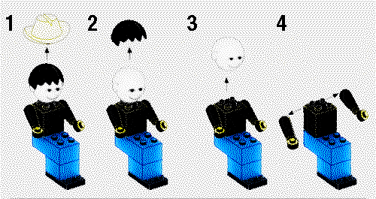
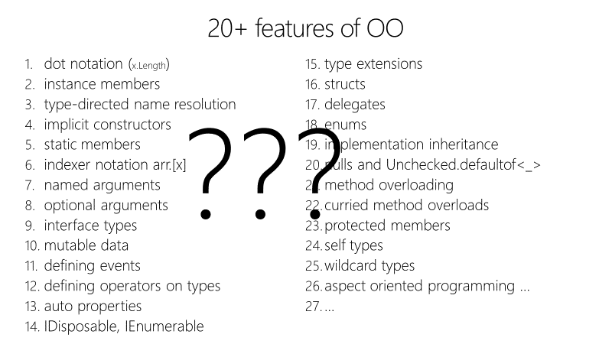
Response 5
Rationally deconstruct Functional and Object Programming

Slide 22


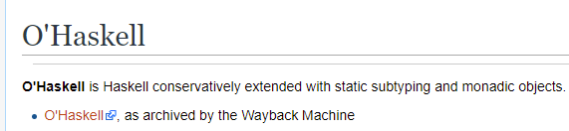
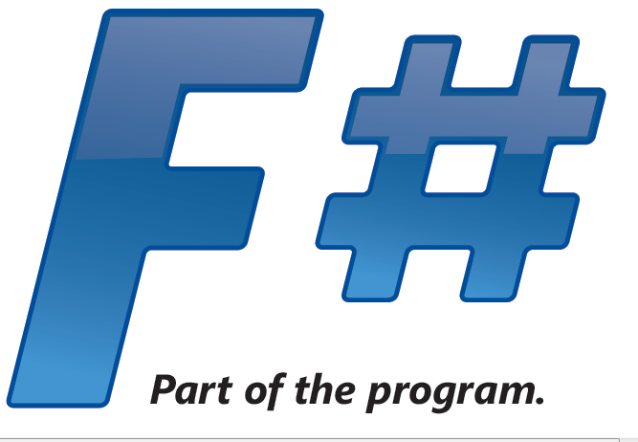
Response 6a
Seek a synthesis!
Make Functional Languages more Object-Oriented!

Slide 23
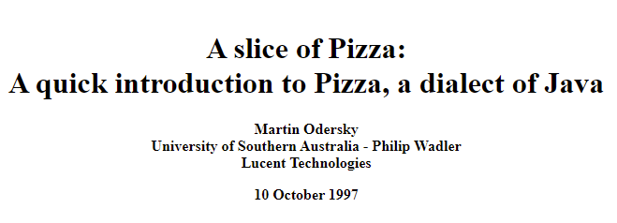
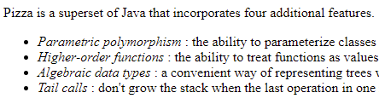


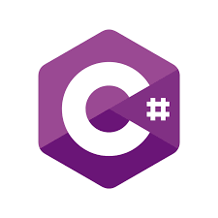

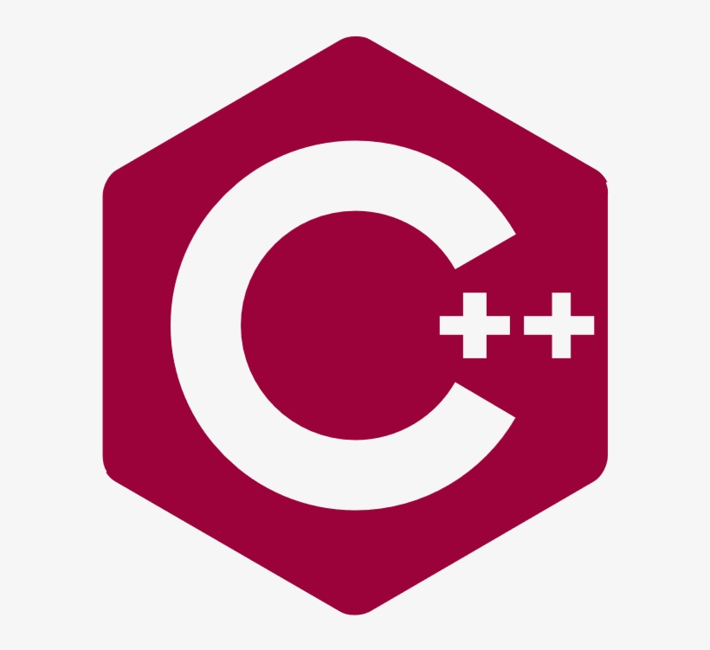
Response 6b
Seek a synthesis!
Make Object-Oriented Languages more Functional!
+ many other more recent examples

Slide 24
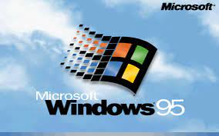
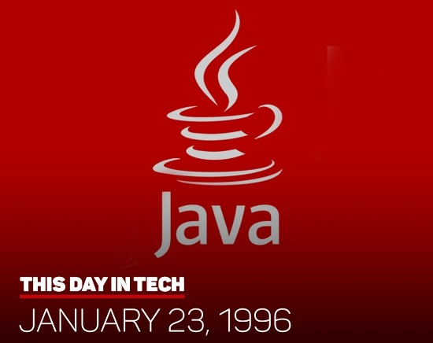
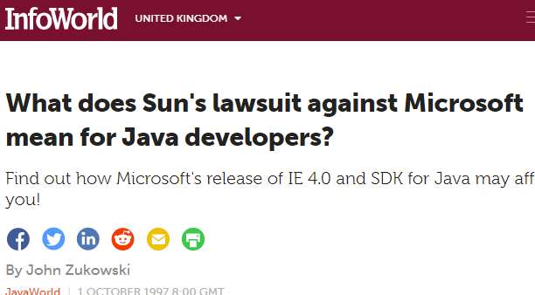


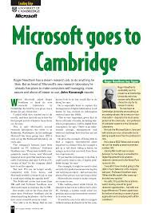

Meanwhile…. Over at Microsoft….

Slide 25
1997 – Microsoft Research founded in Cambridge
All the tribes of computer science descend on Microsoft..
The worlds of Robin Milner and Bill Gates collide…
Much early work centred on .NET

Slide 26
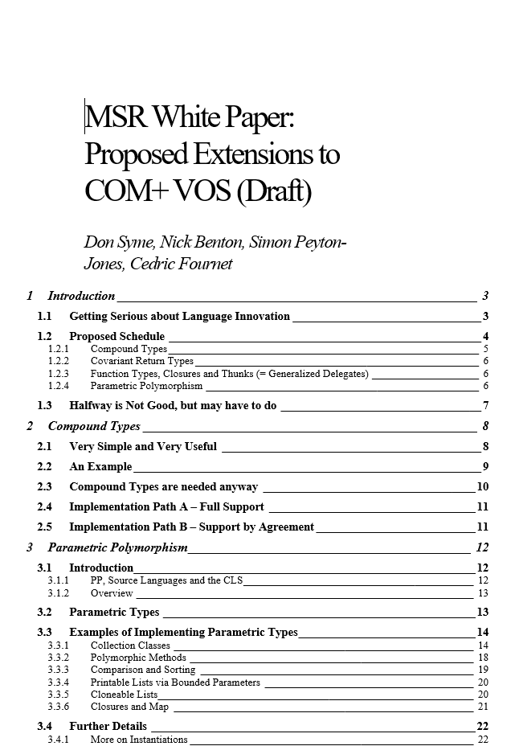
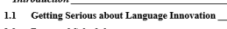
.NET Generics (1998-2004)
Breaking through the nominal, class-based Object-Oriented wall
Influenced by SML, OCaml, more + GJ, Pizza by Wadler/Odersky et al
“Puts .NET 20 years ahead”

Slide 27
By 2003 .NET Generics was safely landed
However, C# 2.0 was still verbose, unusable, untrustworthy (relative to FP)
Sample after sample showed 3x-5x code size difference for like-for-like, full of null checking etc.

Slide 28
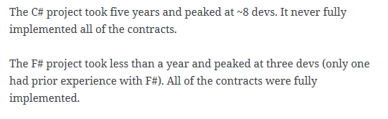
A later example
350,000
lines of C# OO
by offshore team
30,000
lines of robust F#, with
parallel +more features
An application to evaluate the revenue due from Balancing Services contracts in the UK energy industry
http://simontcousins.azurewebsites.net/does-the-language-you-use-make-a-difference-revisited/

Slide 29
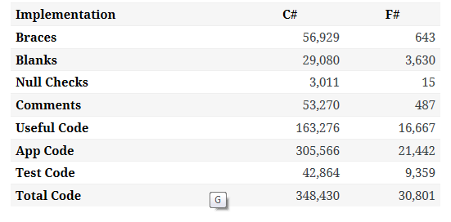

Slide 30
I loved OCaml, by far the best practical language at that time
F# 1.0 was born from an obsession to ensure practical strongly-typed FP was a viable option in the 21st C

Slide 31

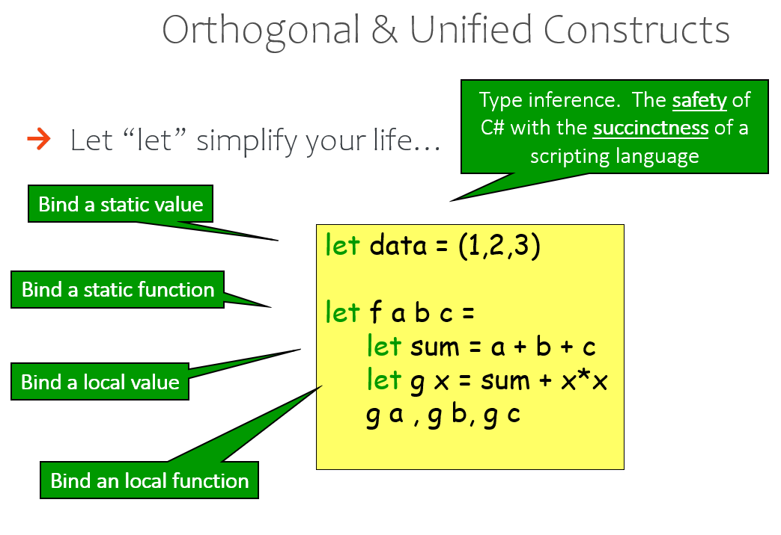
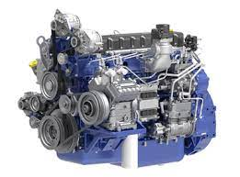
Starting with Core Caml
OCaml
.NET Runtime
(This is a truck engine)

Slide 32
The F# approach
Start with Core Caml
Stay true to core FP principles
Interoperate
Reuse industrial VM+ecosystem
Deconstruct OO, FP, find synthesis
Include IDE tooling, REPL
Deliver and apply in industry
Long-term home at Microsoft (Research)
Focused iterative improvements

Slide 33
Type definitions, modelling, objects
Soundness and
Formalization
Parameterization
Expression-oriented programming
Runtime, ecosystem, interop
Types and Type Inference
Computational
modalities
(comprehensions, async, monads, monoids…)

Slide 34
Nominal objects (classes, interfaces)
Structural objects
Languages must have a formal specification!
Functors (parameterized large components)
Type definitions
Functional objects
Soundness
Soundness is supreme
Functional abstraction and parameterization
Parameterization
Immutable by default, algebraic data
Initialization soundness, no nulls
Expression-oriented programming
Types for modelling, perf, correctness, interop
“F# types are .NET types, .NET types are F# types”
Hindley-Milner for typed succinctness
List comprehensions
Types and Type Inference
Interop
Hindley-Milner modified for objects+more
Monadic notation
Type Providers
Computational
modalities
Fast generic unboxed arith + inline
Rich, compositional computation notation (for comprehensions, queries, async, monads, monoids, applicatives…)
Type-classes and type-level computation
Types for logic and proof

Slide 35
Facing up to some of the Contradictions of the Strongly Typed Functional Tribe

Slide 36
There are contradictions at the heart of the ML family of languages
Purity v. Practicality
Logic v. Pragmatism

Slide 37
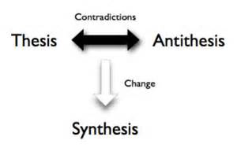
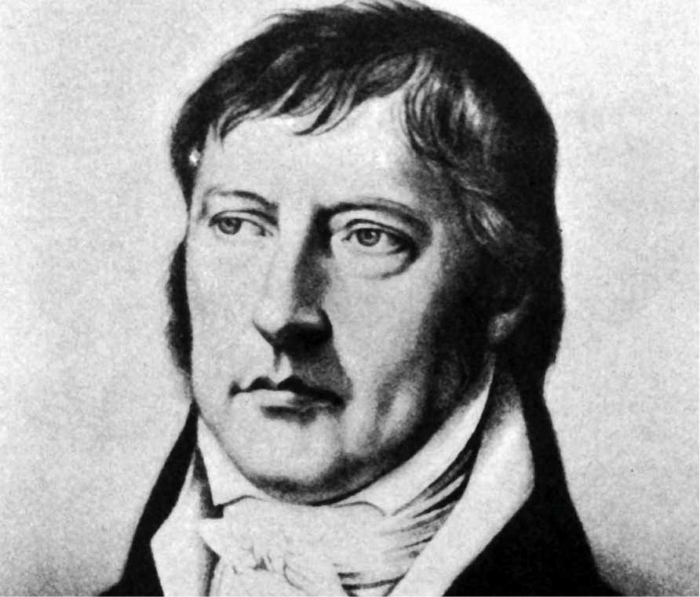
Embracing Dialectics

Slide 38
Contradiction #1
All practical typed languages need cheap and effective type declarations that include encapsulation
Previous MLs had awkward variants of that (abstype)
Functional
Objects
2006: F# Object Programming
modified Hindley-Milner, type-directed name resolution,
nominal, subtype-friendly, delegation-oriented, expression-friendly

Slide 39
F# : Objects + Functional ️
Recovers ergonomic simplicity
for encapsulation, works with type inference
and interop, immutable by default
type Vector2D(dx:double, dy:double) =
let d2 = dx*dx+dy*dy
member _.DX = dx
member _.DY = dy
member _.Length = sqrt d2
member _.Scale(k) = Vector2D (dx*k, dy*k)
Inputs to object
construction
Functional object internals
Exported properties
Exported method

Slide 40
Deconstructing Object Programming

Slide 41
The 20+ features of OO
dot notation (x.Length)
instance members
type-directed name resolution
implicit constructors
static members
indexer notation arr.[x]
named arguments
optional arguments
interface types
mutable data
defining events
defining operators on types
auto properties
IDisposable, IEnumerable
type extensions
structs
delegates
enums
implementation inheritance
nulls and Unchecked.defaultof<_>
method overloading
curried method overloads
protected members
self types
wildcard types
aspect oriented programming …
…
???

Slide 42
Some make F# a better API language Some make F# a better implementation language Some are part of an interop standard Some are not needed

Slide 43
The 20+ features of OO
Embrace
dot notation (x.Length)
instance members
type-directed name resolution
implicit constructors
static members
indexer notation arr.[x]
named arguments
optional arguments
interface types and implementations
mutable data
operators on types
auto properties
IDisposable, IEnumerable
type extensions
events
structs
delegates
enums
type casting
large type hierarchies
implementation inheritance
nulls and Unchecked.defaultof<_>
method overloading
curried method overloads
protected members
self types
wildcard types
aspect oriented programming …
…
Down the object rabbit hole
Use where necessary, use tastefully, use respectfully, use sparingly
Not supported

Slide 44
The 20+ features of OO
Love
dot notation (x.Length)
instance members
type-directed name resolution
implicit constructors
static members
indexer notation arr.[x]
named arguments
optional arguments
interface types and implementations
mutable data
operators on types
auto properties
IDisposable, IEnumerable
type extensions
events
structs
delegates
enums
type casting
large type hierarchies
implementation inheritance
nulls and Unchecked.defaultof<_>
method overloading
curried method overloads
protected members
self types
wildcard types
aspect oriented programming …
…
Mostly Avoid
Tolerate
Forget

Slide 45
Object Programming v. Object-Oriented Programming

Slide 46
Object Programming focuses on … succinct coding notational convenience API ergonomics good naming practical encapsulation sensible, small, composable abstractions expression-oriented object implementations delegation and closure making simple things out of (potentially complex) foundations

Slide 47
Object-Oriented Programming seems to focus on … objects as a single, dominant, mentally stifling paradigm pointless hierarchical classification (Animal, Cat, Dog, AbstractJellyBeanFactoryDelegator) large, cumbersome abstractions with many holes and failure points declarations not expressions composition through… more objects, more hierarchies, more names making complex things out of complex foundations

Slide 48
The F# approach is to embrace object programming, make it fit with the expression-oriented typed functional paradigm but not embrace full “object-orientation” (unless you happen to be in a project using that technique)

Slide 49

Remember the eternal sweet spot of programming! Functions + Data + Types

Slide 50

Contradiction #2
Pattern matching only over concrete representations is, in practice, a catastrophe
This was a contradiction in all functional languages until F#
https://www.pure.ed.ac.uk/ws/portalfiles/portal/17084823/Milner_R_1982_How_ML_Evolved.pdf
Pattern Matching
Abstraction
2006: F# Active Patterns
Views made practical and simple.
Concomitant with Scala extractors, leads to Haskell view patterns (less used), C# pattern matching

Slide 51
Contradiction #3
MLs had no list comprehensions
MLs had no monad syntax
MLs had nothing like this, and it really hurt in practice
Lambda is everything
Computational modalities
(co-routines, tasks, multi-threading, monads, monoids, comprehensions, queries, DSLs)
1993: OCaml embraces Algol-like control syntax within an expression-based functional language
2007: F# Comprehensions, Async and Computation Expressions gives modal interpretation to this

Slide 52
Computational modalities in C#, F# (computation expressions)
C# Iterator methods (from Icon)
C# Query expressions
modality { code }
C# Collection initialization
C# Async methods
2007 – monads, monoids, async, comprehensions
2012 – queries, extended comprehensions
2020 – applicatives
C# Async iterator methods

Slide 53
Computational modalities in C#, F# (computation expressions)
C# Iterator methods
seq { code + yield }
C# Query expressions
query { code + yield + custom }
C# Collection initialization
list { code + yield }
C# Async methods
async { code + let! }
C# Async iterator methods
asyncSeq { code + let! + yield }
coroutine { code + yield() }

Slide 54
seq { … }, [ … ], [| … |]
✗
✓
let rec allSymbolsInEntities compGen (entities: FSharpEntitylist) =
List.concat [
entities;
(e.GenericParameters
|> List.filter (fun gp -> compGen || not gp.IsCompilerGenerated));
(e.MembersFunctionsAndValues
|> List.filter (fun x -> compGen || not x.IsCompilerGenerated)
|> List.collect (fun x ->
List.cons x
(x.GenericParameters
|> List.filter (fun gp -> compGen || not gp.IsCompilerGenerated))));
e.UnionCases;
(x.UnionCaseFields
|> List.filter (fun f -> compGen || not x.IsCompilerGenerated));
(x.Fields
|> List.filter (fun f -> compGen || not x.IsCompilerGenerated));
allSymbolsInEntities compGen e.NestedEntities ]
let rec allSymbolsInEntities compGen (entities: FSharpEntitylist) =
[ yield! entities
for gp in e.GenericParameters do
if compGen || not gp.IsCompilerGenerated then
yield gp
for x in e.MembersFunctionsAndValues do
if compGen || not x.IsCompilerGenerated then
yield x
for gp in x.GenericParameters do
if compGen || not gp.IsCompilerGenerated then
yield gp
yield! e.UnionCases
for f in x.UnionCaseFields do
if compGen || not f.IsCompilerGenerated then
yield f
for x in e.FSharpFields do
if compGen || not x.IsCompilerGenerated then
yield x
yield! allSymbolsInEntities compGen e.NestedEntities ]
v.

Slide 55
History of async/await and computational modalities in C#, F#
C#
F#
1970-90s
MLDonkey,
List Comprehensions,
Haskell Monads,
Coroutines, Promises
SNOBOL,
Icon Iterators
2002, Todd Proebsting,
MSR, Uni Arizona
C# 2.0 Iterator Methods
2002
ML, Haskell, COmega
2006, Erik Meijer,
Microsoft
F# 1.9 Sequences
F# 1.9 Async/Await
F# 1.9 Comprehensions
F# 1.9 Comp. Exprs.
2007
C# 3.0 LINQ queries
Axum+others
Gustaffson et al,
Microsoft
F# 3.0 CEs Support Queries
F# 3.0 CEs Support Async Sequences
2011
C# 5.0 Async/Await
Hejlsberg,
Torgersen et al
Async/Await in Python, C++, Java,
Typescript + others
Haskell Applicatives
Torgersen
et al
2020
C# 8.0 Async Iterator Methods
F# 5.0 CEs Support Applicatives

Slide 56
Contradiction #4
No versions of ML had taken data-access or data interop seriously
F# had some libraries from .NET. However we wanted more fluency, more automation, more programmability of interop
Typed Code
External Data
2012: F# Type Providers
(compile-time meta-programming to compute type
spaces based on external information sources)

Slide 57
The More Recent History of F# (2012+)
So much I could say
2010 – F# 2.0, “Parachutes Into the Dark Heart of the Industry”
2012+ – F# 3.0, 3.1
2014-2016 – Fully embrace Cross-Platform, Open-Source, Cloud, Web
2016+ – F# 4.0, 4.1, 4.5, 4.7
2020 – F# 5.0
2021 – F# 6.0 in preparation

Slide 58
F# Today
F# has a core position as “typed functional for .NET and JavaScript”
Delivery in the .NET SDK, F# exists wherever C# exists
Highly performant
IDE tooling by two major vendors
Strong for web-client, mobile, server, cloud, deep-learning
Fully open design and engineering processes
A practical functional-first methodology
An engaged and enjoyable community

Slide 59

F# get started
dotnet new -lang F# dotnet build
F# tools are part of the .NET SDK, available everywhere
www.dot.net

Slide 60

F# for the web backend
dotnet new -i "giraffe-template::*" dotnet giraffe
High perf, functional server-side programming
A functional ASP.NET Core micro web framework for building rich web applications. github.com/giraffe-fsharp/Giraffe

Slide 61


F# for the web frontend (JavaScript)
dotnet new -i "Fable.Template::*" dotnet new fable npm install npm start
You can use F# as a JavaScript language
websharper.com
fable.io
Notes:
WebSharper also includes an excellent JavaScript compiler for F#

Slide 62


F# for the full stack with SAFE
dotnet new -i SAFE.Template dotnet new SAFE dotnet tool restore dotnet run
=
+
+
Notes:
NOTE: other excellent full-stack options exist, including “WebSharper”

Slide 63

https://fsharp.org/history
Lambdas in the roof?

Slide 64
The influence of F#
Culturally, F# core team existed “right next door” to C# core team, leading to many direct influences both ways
via Hejlsberg, Meijer, Hoban, Parsons, Torgersen + others

Slide 65

The $1B mistake is finally corrected.
Real cost $100B??
.NET libraries now come with ubiquitous nullability annotations
+ C# 9.0 records, top-level statements

Slide 66
Other Influences of F#...
Scala (via Odersky + others – extractors + more)
TypeScript, Swift, Elm, Kotlin (F# is a reference point)
Python (via C# - async)
Java, C++ … (via C# - async)

Slide 67
Concluding Remarks

Slide 68
Concluding Notes
The programming world has corrected the OO dominance of the 90s
Generics, lambdas, parameterization, immutability, algebraic types, various computational modalities, type inference have now rightly occupied their place as practical core techniques in nearly all programming languages
“Why no one uses Functional Programming” has been consigned to history
F# has been a part of this story since 2003
Part of the reaction of the functional tribe to the OO tidal wave
Stayed true to its core design goals
Many practical additions to the expression-oriented, statically typed paradigm
A strong user base and a secure future

Slide 69
The golden thread of ML is the simplicity of Functions + Data, e.g.
let f x = (x, x)
type term = T of string * term list
…
Milner, Newey, Morris saw this in 1974 and it’s stayed true.

Slide 70
Thank you!! Questions?

